Slide 2
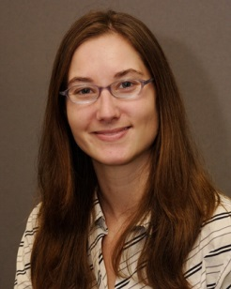
Facilitation, technical support and production by Melissa Hooke

Slide 6
Sharing Memories
Using Reminiscence Activities With Seniors

Slide 7
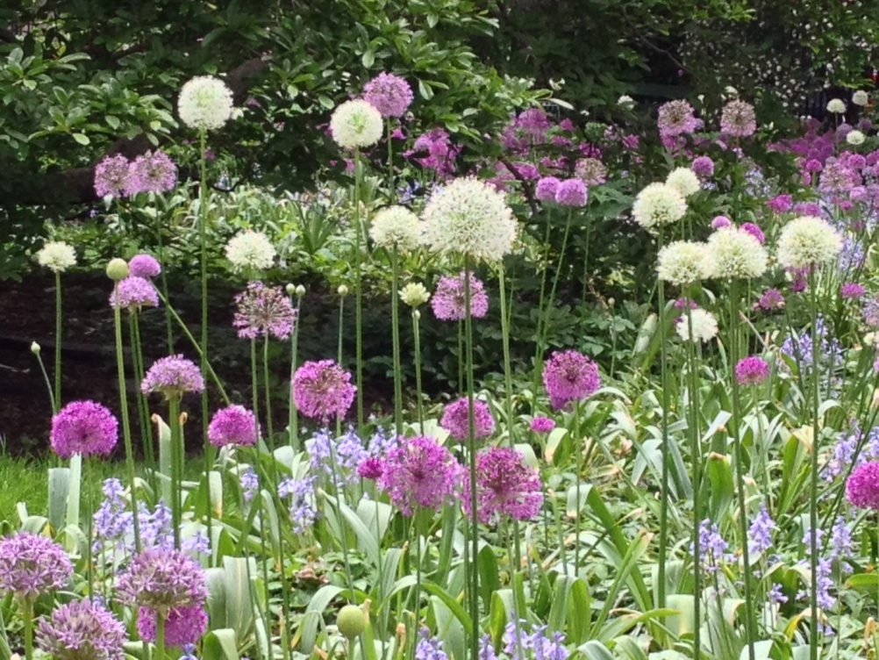
Today’s Webinar
Introductions
Accessing the webinar features…
Handouts

Slide 8
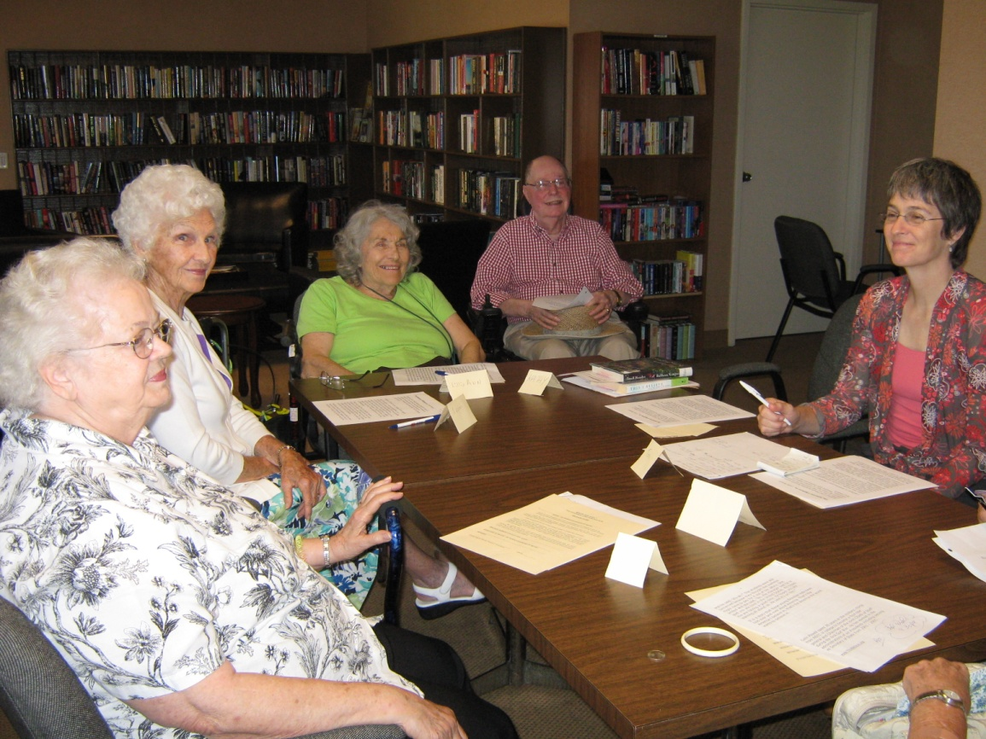
The Nature of Library Programs
Most programs = presenter + audience
Adding the element of memory

Slide 9
What is reminiscence?
The act of recollecting our past experiences or events.
Through reminiscing we share our lives with others and remind ourselves of important times and relationships.

Slide 10
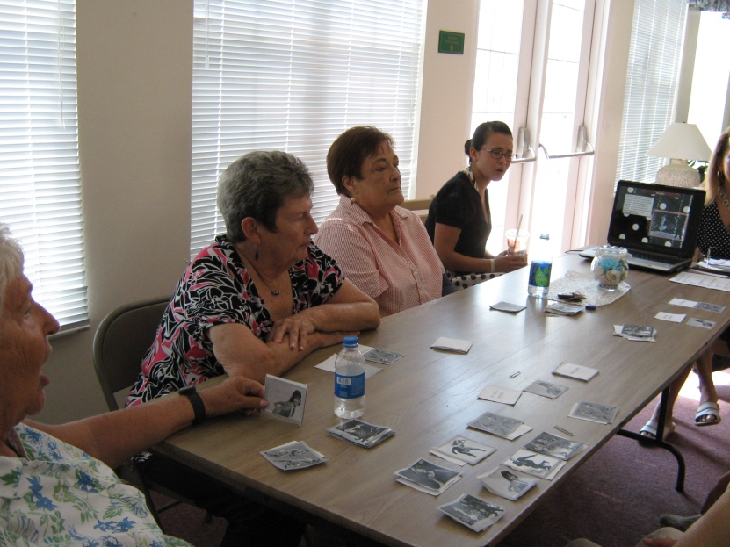
Is this…
Life Review?
Oral History?
Guided Autobiography?

Slide 11
What value is there in reminiscing?
Reliving important times and relationships
Passing on family stories and traditions
Helping to understand our lives
Reflecting on and assessing life achievements
Rediscovering the expectant joy of our youth

Slide 12
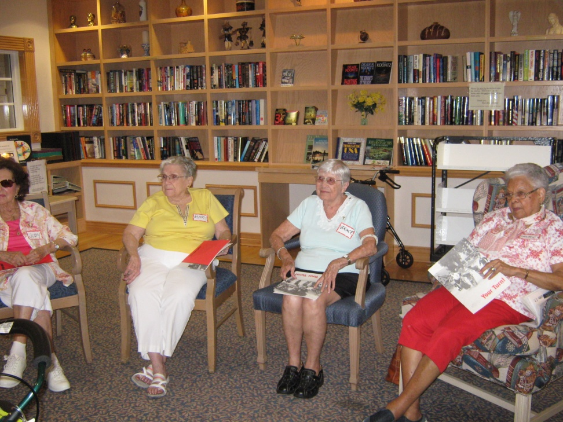
Who benefits from reminiscing?
Older adults
Intergenerational groups (see LegacyProject.org)

Slide 13
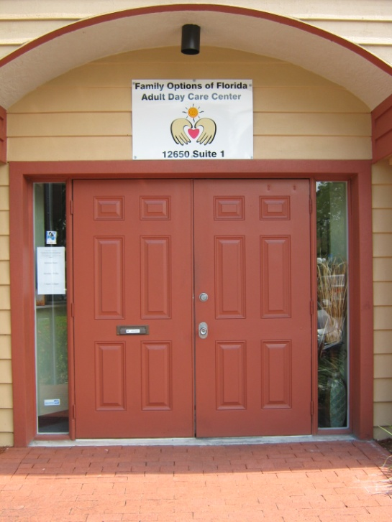
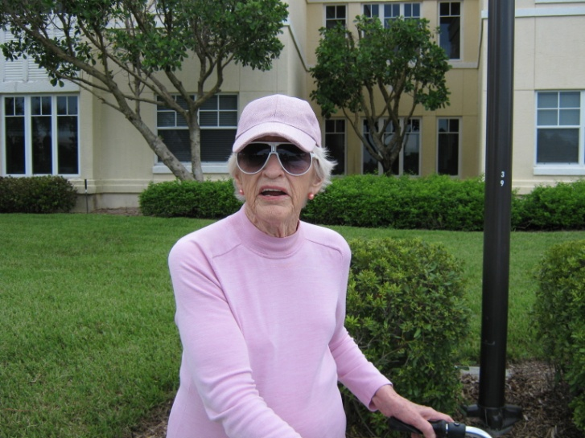
We’re reaching older adults who…
Live in assisted living facilities and retirement communities
Attend adult daycare and congregate meal programs

Slide 14
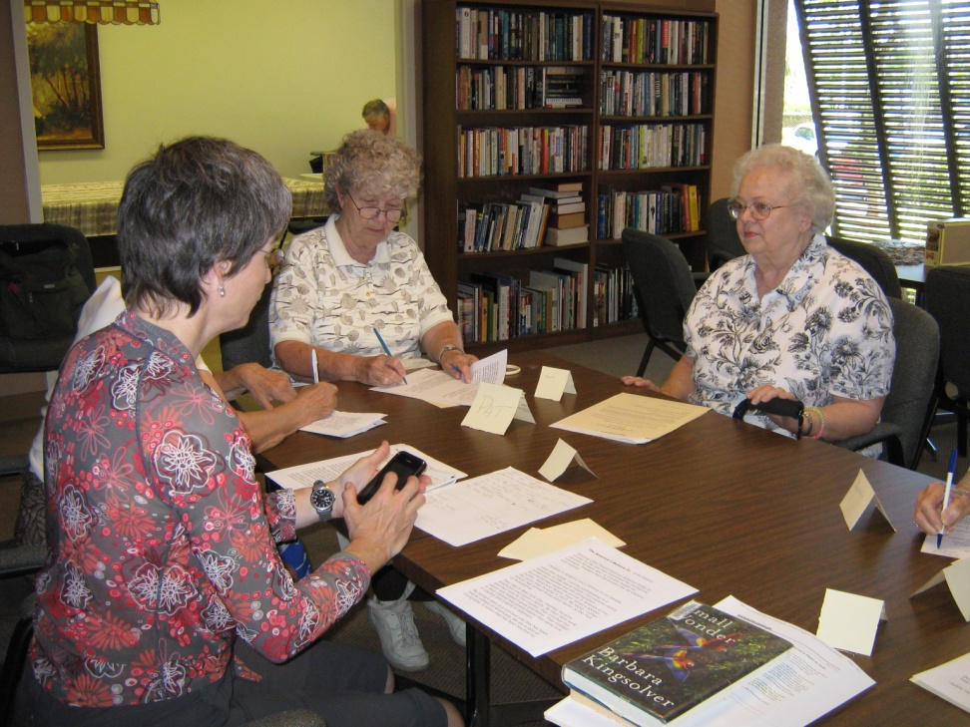
What does reminiscence look like?
Typical conversations
Questions that promote discussion
Group size and location
Members of the group

Slide 15
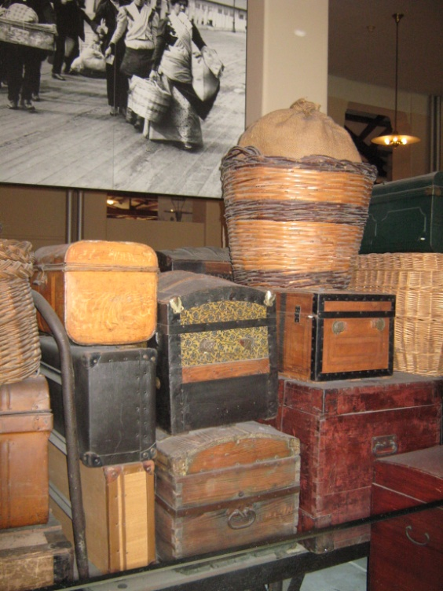
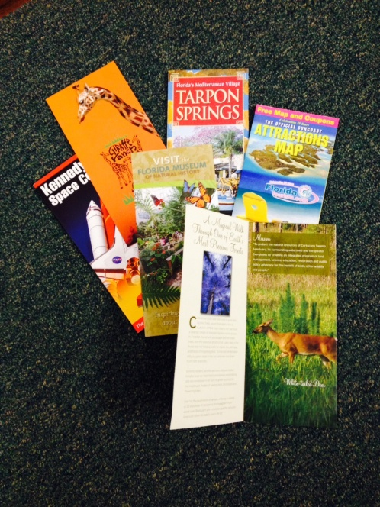
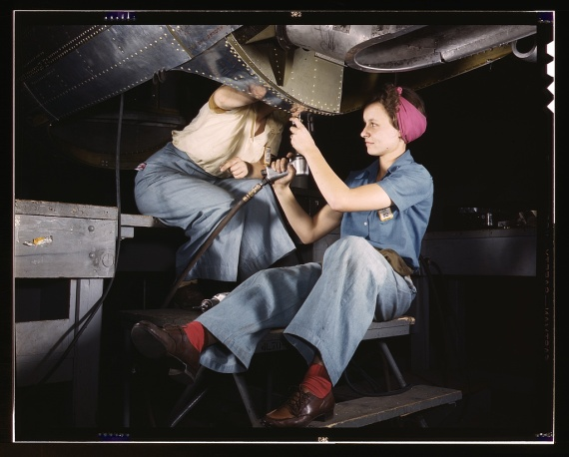
Triggering & Stimulating Memories
It’s more than, “Tell me about your life.”
Our senses are the building blocks of memory.

Slide 16
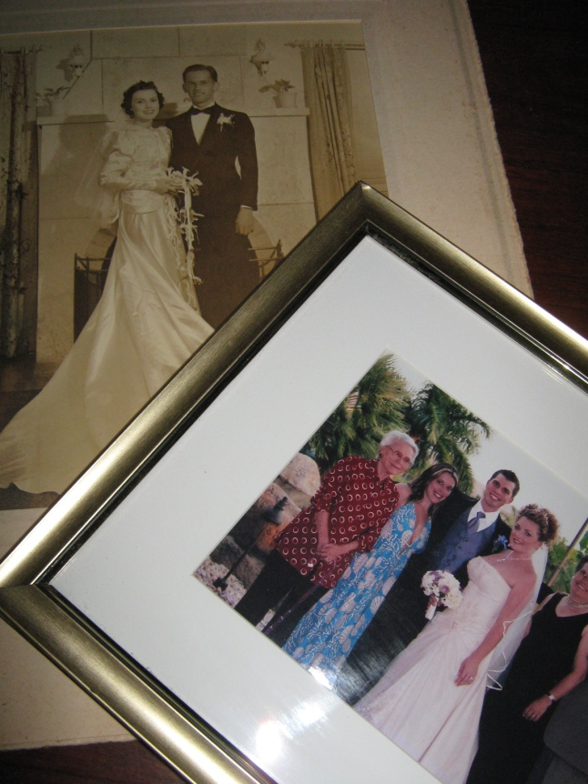
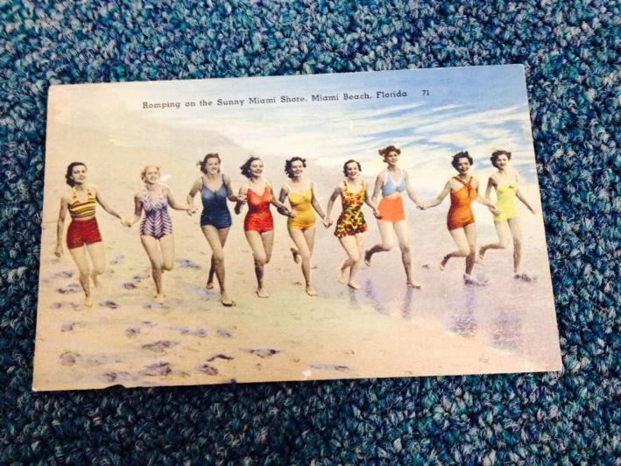
Visual Triggers
Photos
Ads, flyers, postcards
Movie clips
Maps

Slide 17
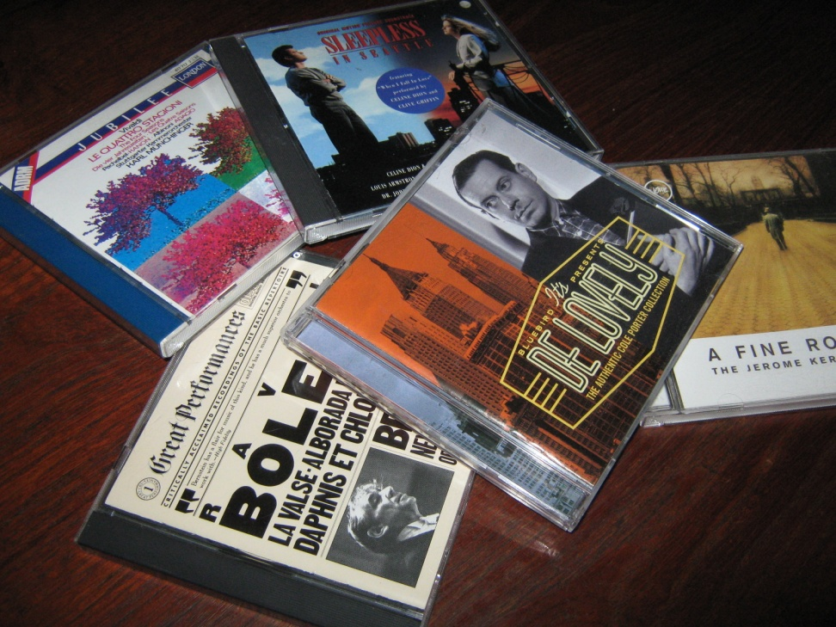
Sound Triggers
Music and songs
Old radio shows
Voices of famous people
Nature sounds

Slide 18
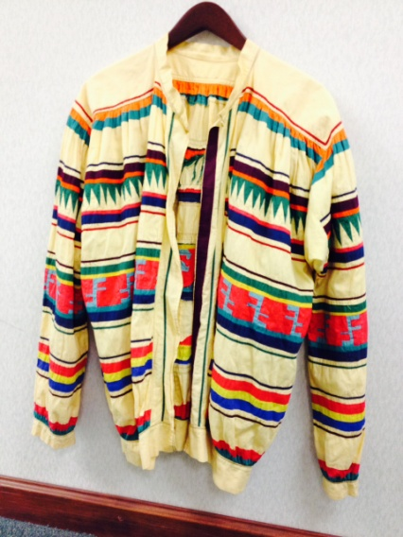
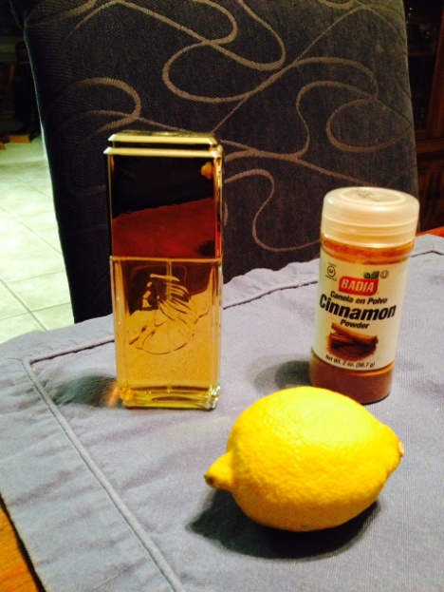
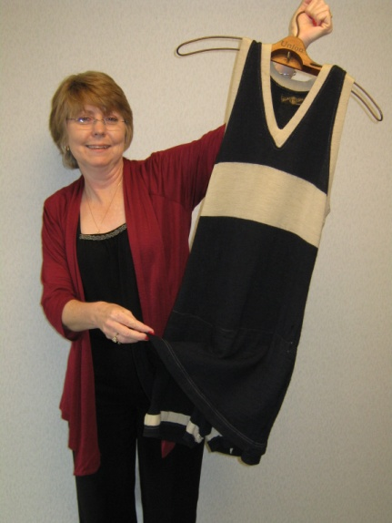
More Triggers
Aroma and Taste
Touch
Foods
Fragrances
Daily life smells
Objects
Human touch

Slide 19
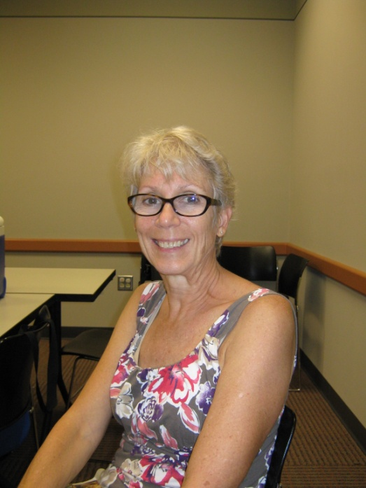
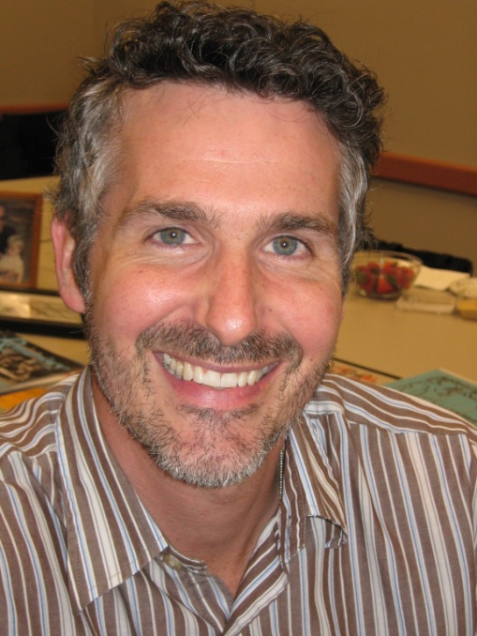
Who should do this?
Our roles
Library staff and volunteers
Criteria and training

Slide 20
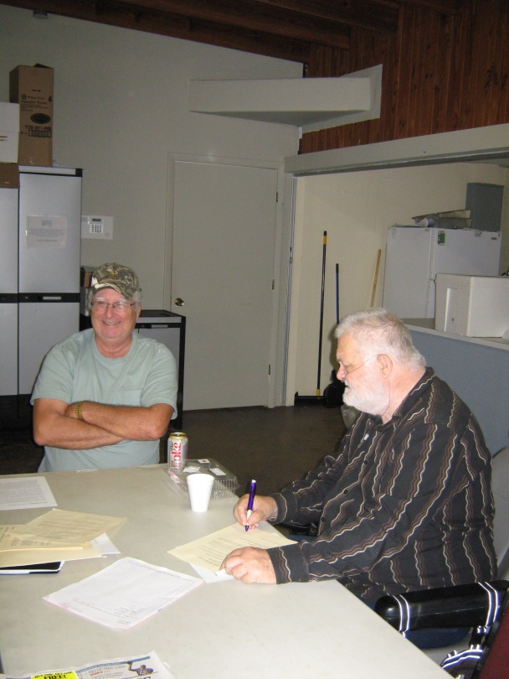
Activities Using Reminiscence
Literature-based discussions
Community conversations
People and stories
Book discussions
Readers theater
Writing and journaling
BiFolkal kits and materials
Senior storytelling

Slide 21
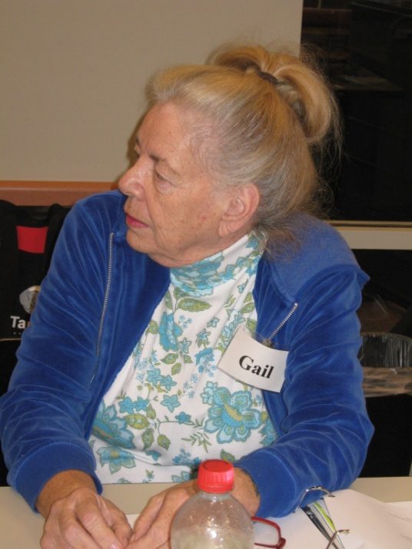
Community Conversations
Theme-based activities with thoughtful discussion
Typical activities
2 sample discussions
Successful topics

Slide 22
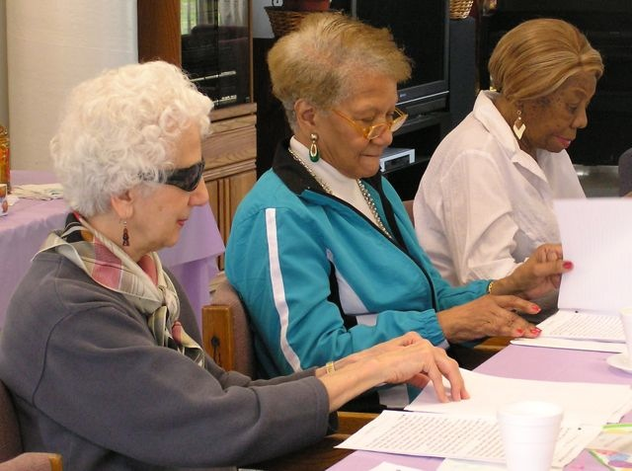
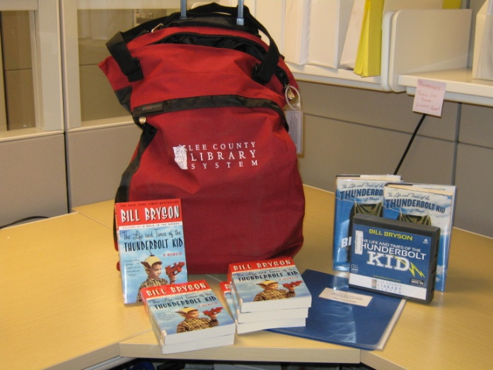
More Activities
People and Stories
Book Discussion Groups
Process
Audience
Typical discussion
Discussion format
Choice of titles

Slide 23
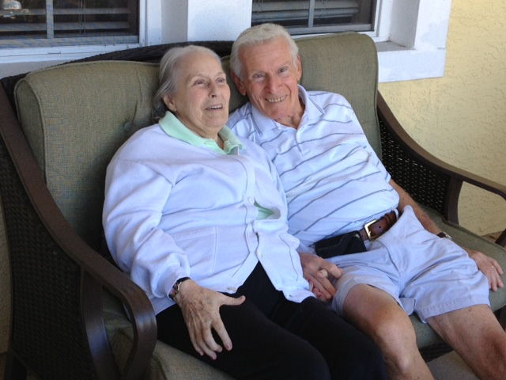
More Activities
Readers Theater
Writing and Journaling
Program format
Library or senior led
Sample themes
Program formats
Activities

Slide 24
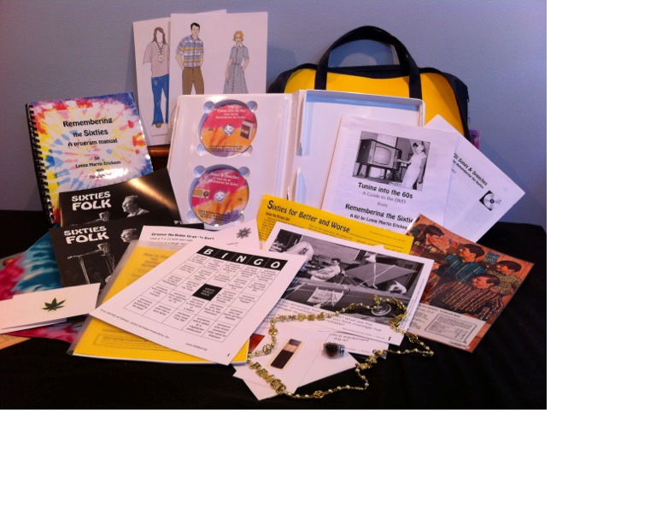
BiFolkal Kits & Materials
Program materials for remembering and sharing
History
Kit components
Program activities

Slide 25
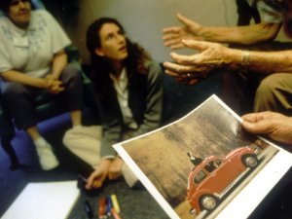
Senior Storytelling
Program format
Involving seniors
Time Slips programs

Slide 26
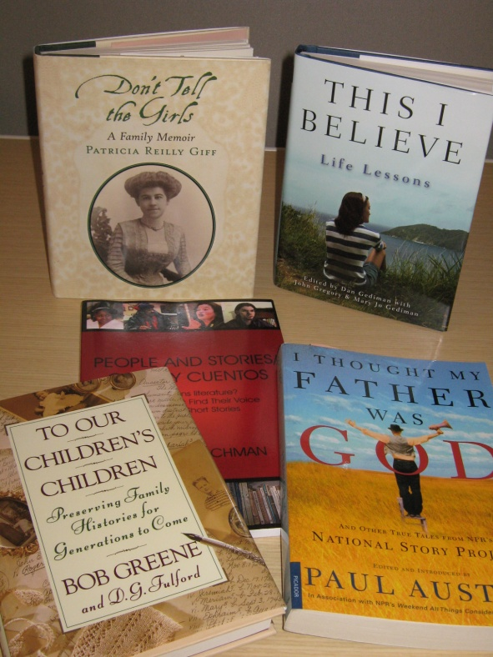
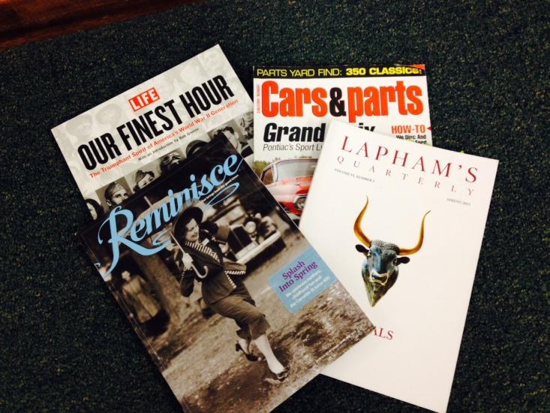
Sources of Stories, Essays & Poems
What makes a good reading?
Online sources
Library resources
Permissions

Slide 27
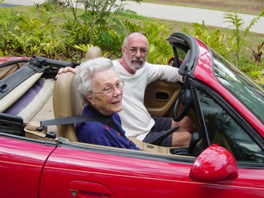
Where do we go from here?
Questions
For further information…

Slide 28
Rick Scott, Governor
Ken Detzner, Secretary of State
Florida Department of State
Division of Library and Information Services
This publication has been funded under the provisions of the Library Services and Technology Act, from the Institute of Museum and Library Services, administered by the Florida Department of State’s Division of Library and Information Services.

